Slide 1
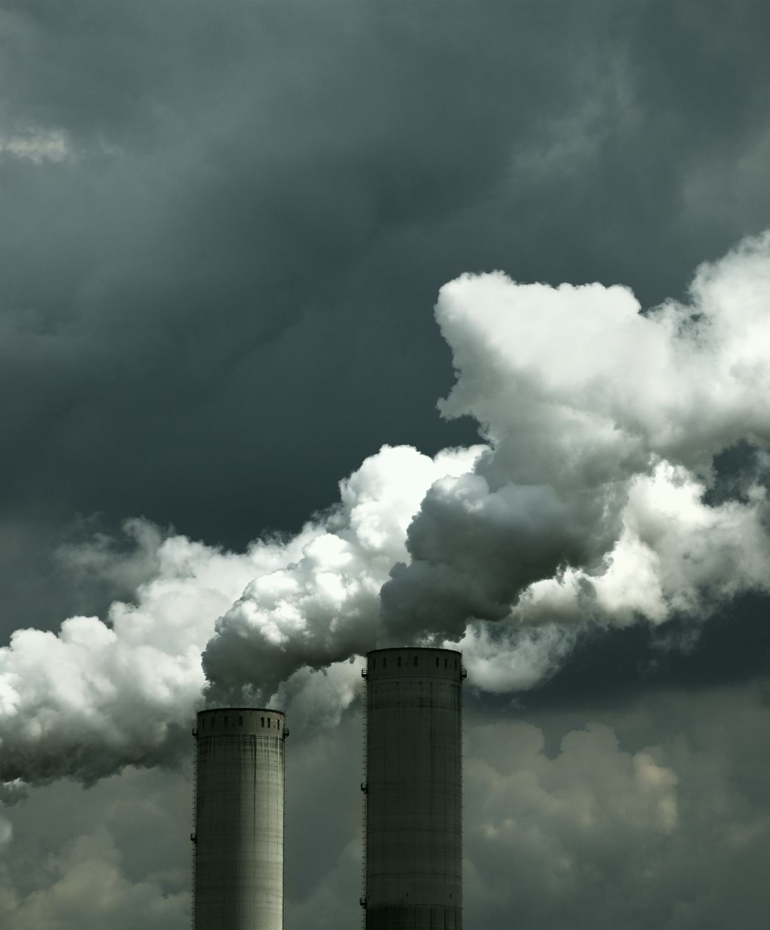
Unearthing environmental CO2 emission

Slide 2
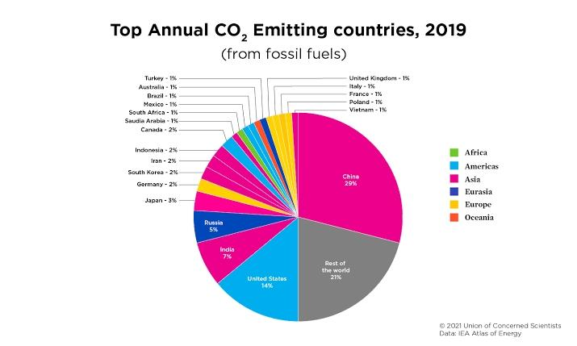
CO2 per captia

Slide 3
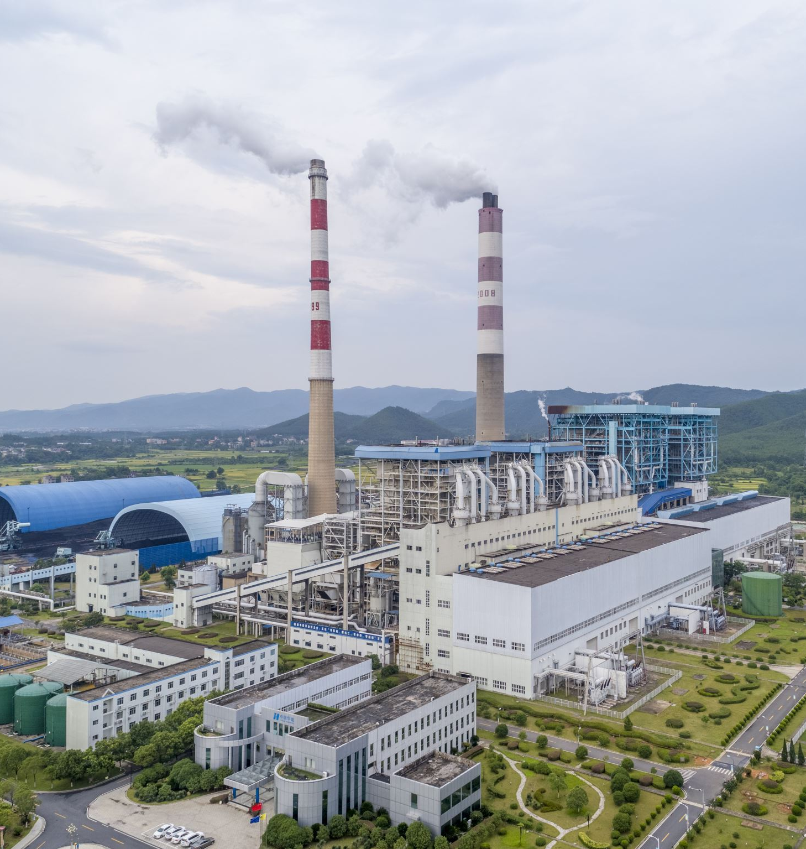
CO2 Emissions

Slide 4
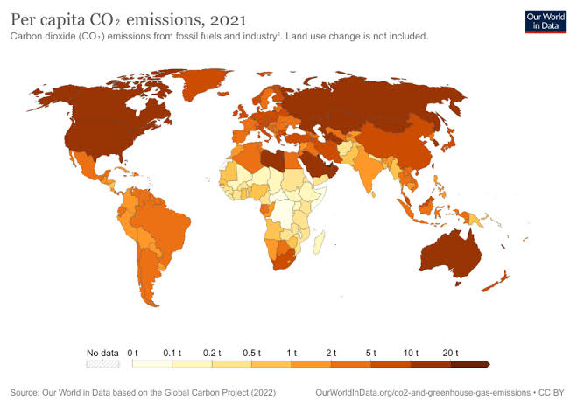
CO2 emission
Carbon dioxide emissions or CO₂ emissions are emissions stemming from the burning of fossil fuels and the manufacture of cement; they include carbon dioxide produced during consumption of solid, liquid, and gas fuels as well as gas flaring

Slide 5
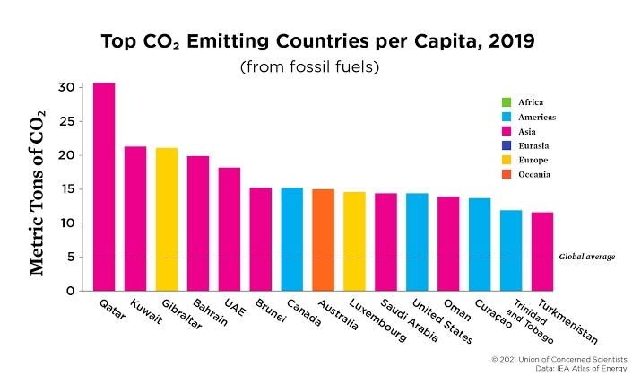
Top countries

Slide 6
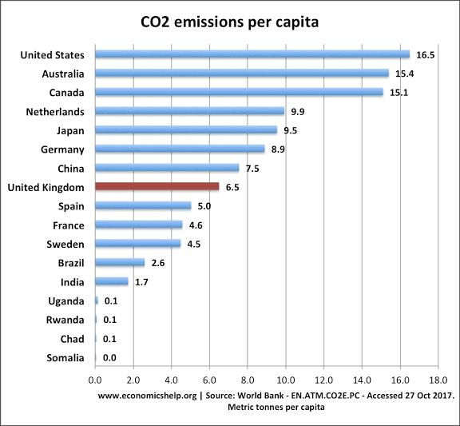
Per Capita
Despite the decline in 2020, global energy-related CO2 emissions remained at 31.5 Gt, which contributed to CO2 reaching its highest ever average annual concentration in the atmosphere of 412.5 parts per million in 2020 – around 50% higher than when the industrial revolution began.

Slide 7
THANK YOU

